Slide 1
A brief overview of the 1.5°C climate goal
Impacts, Implications, Risks and Opportunities
Jérôme Hilaire
Smart & Green on Stage
27th September 2019
Berlin
Notes:
Thanks XXX for the kind introduction and thank you all for sparing me a few minutes to talk about our climate emergency.
Today I’d like to give you a brief overview of the 1.5°C climate goal. I’ll talk about the potential impacts associated with a warming of 1.5°C and the associated risks. I’ll also talk about the implications of staying below 1.5°C of warming and the associated risks and opportunities.
Let’s start with a little survey. Please raise your hand if you want to say yes.
How many of you experienced the European heatwaves this summer?
How many of you think that they have been influenced by human-induced climate change?
How many of you find our current climate situation worrying?

Slide 2
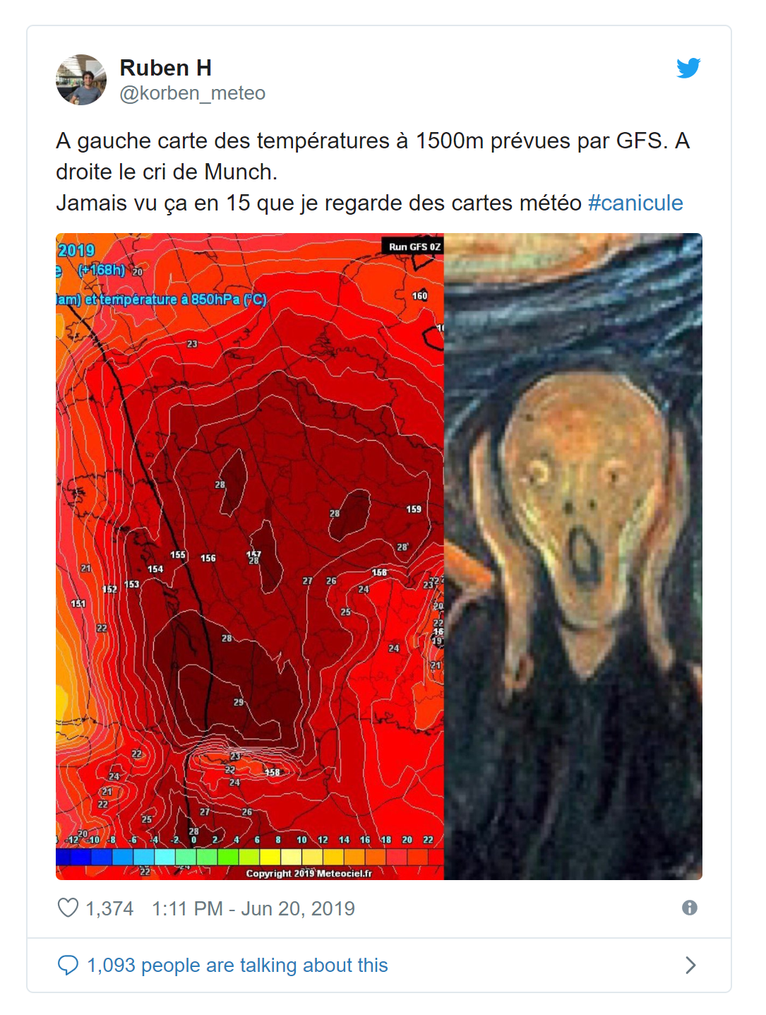
Feeling global heating: 2019 heatwaves
We can feel and observe climate change-
related hazards
This is worrying.

Slide 3

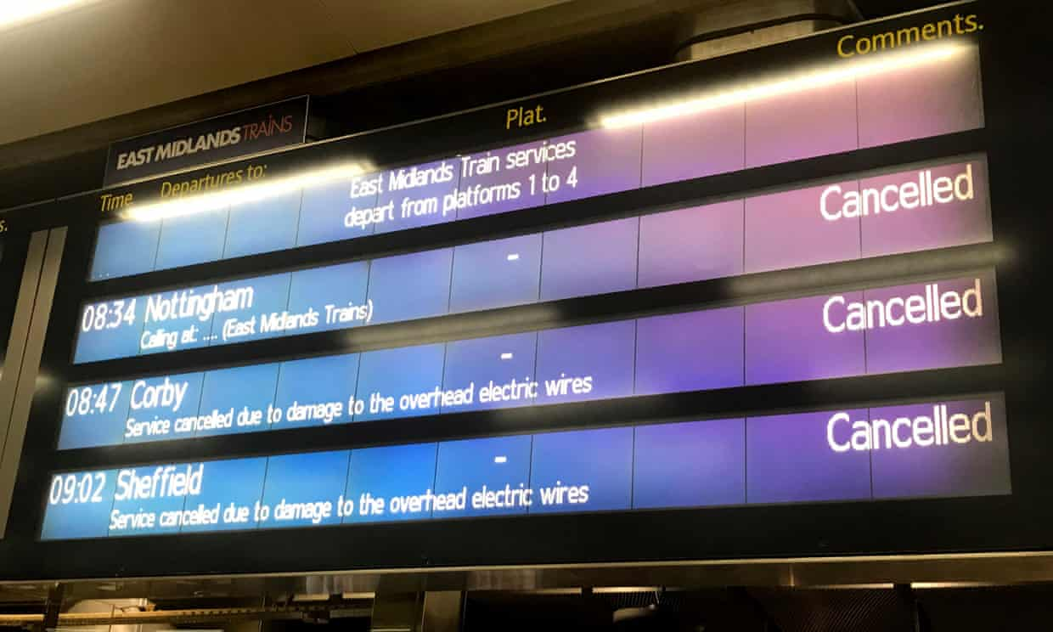


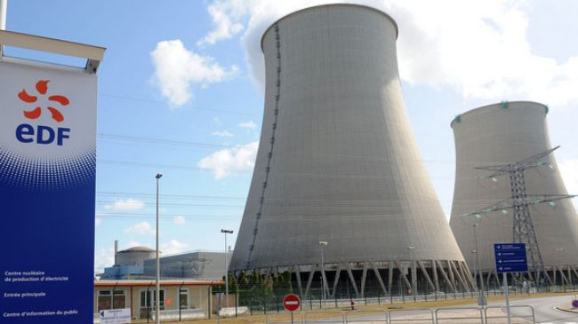
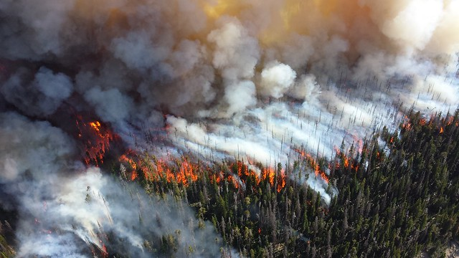

Feeling global heating: 2019 heatwaves
Sources: Guardian 2019 (Georgina Stubbs/PA), @jack7moss /Twitter, PressTV, dubrevetaubac.fr, NPS Climate Change Response, The Blue diamond gallery,

Slide 4
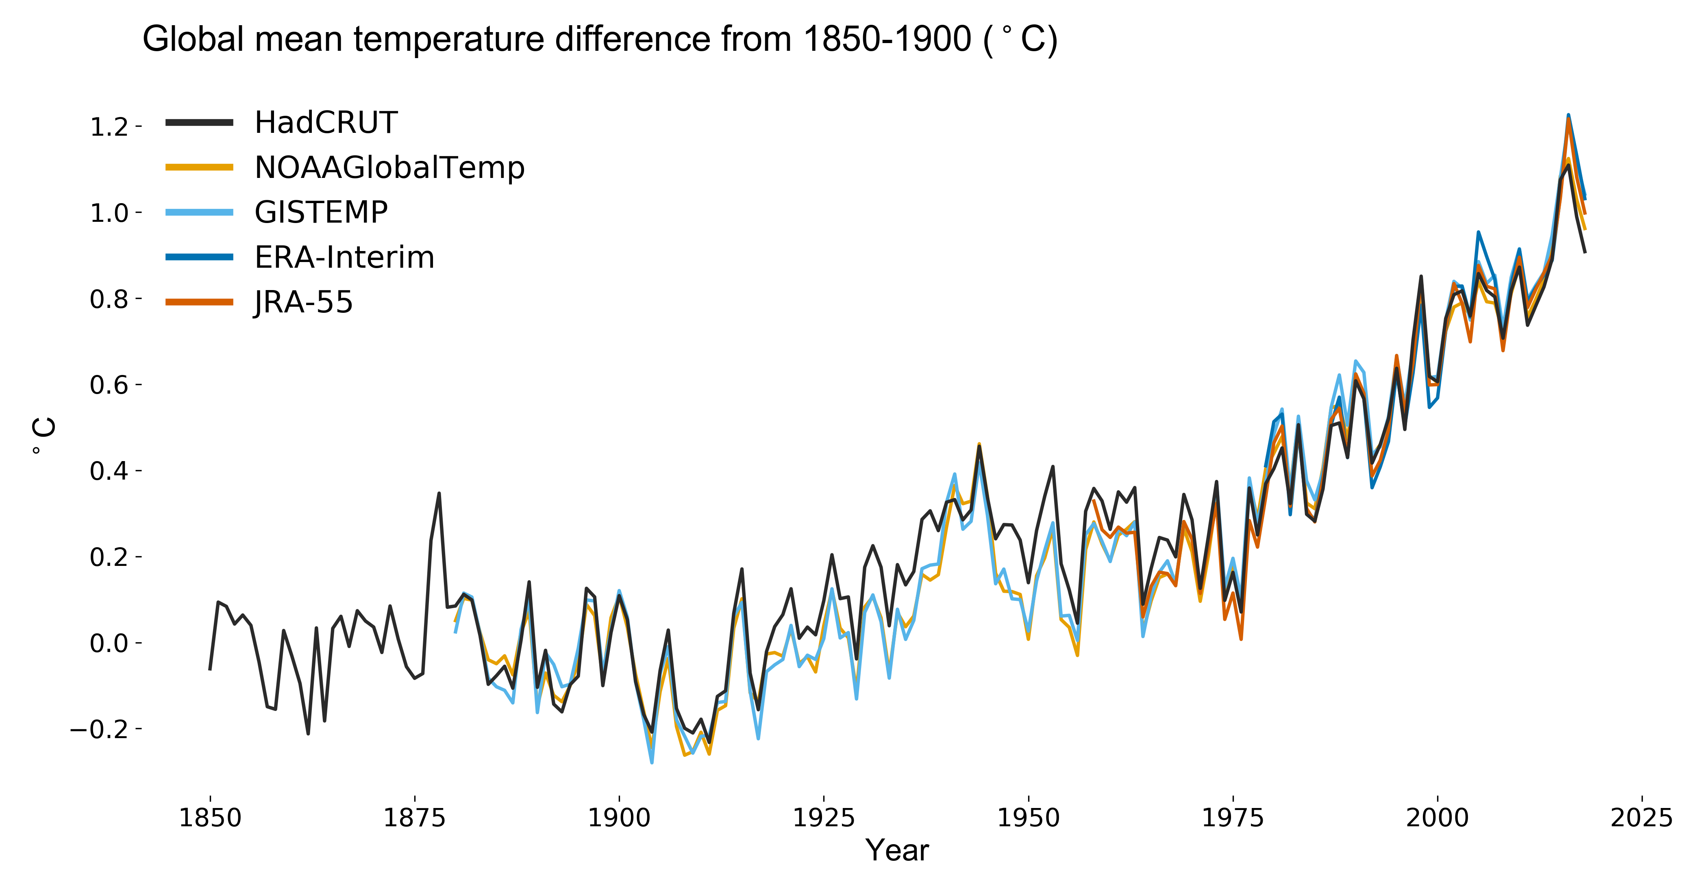
Overwhelming evidence of climate change
We are here
+1°C
Source: MetOffice, WMO

Slide 5
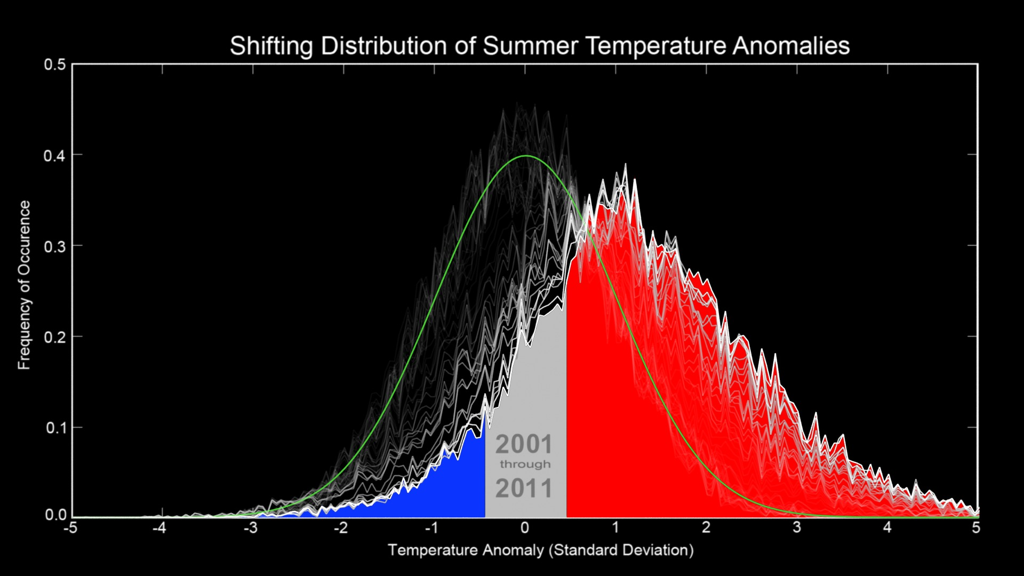
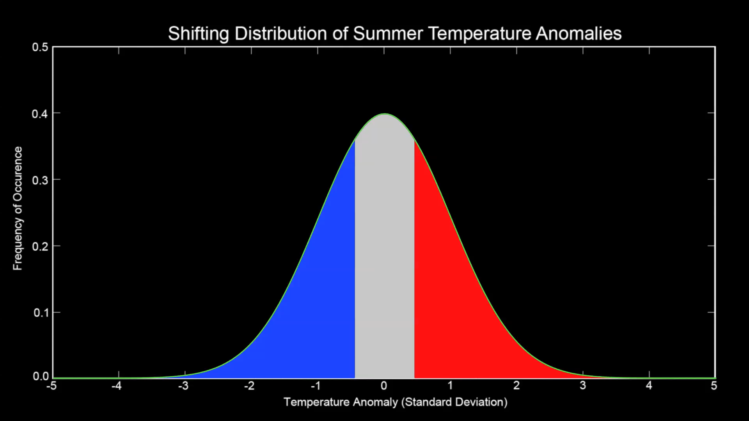
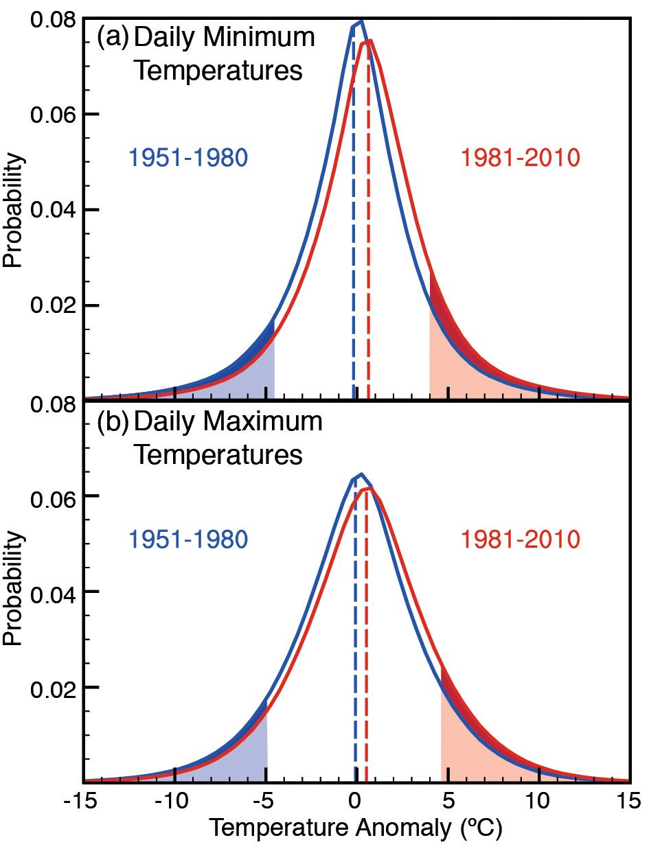
Overwhelming evidence of climate change
1950-1960
2001-2011
+3SD
~ 10%
~0.1%
Source: NASA Scientific Visual Studio 2012 (https://svs.gsfc.nasa.gov/3975)

Slide 6
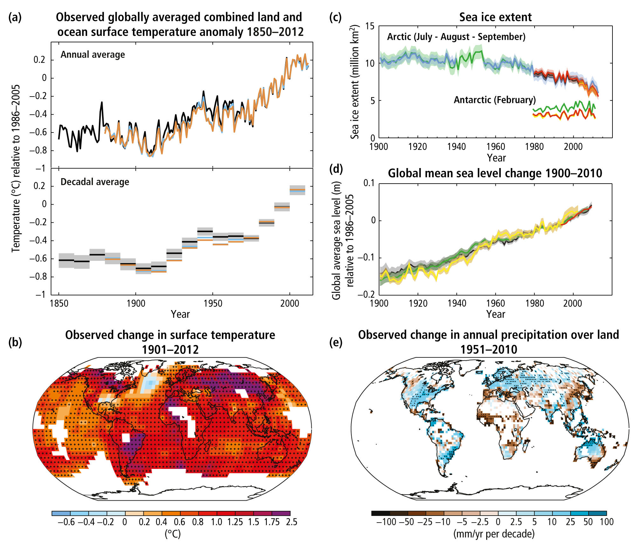
Overwhelming evidence of climate change
Source: IPCC AR5 SYR 2014 (SPM)

Slide 7
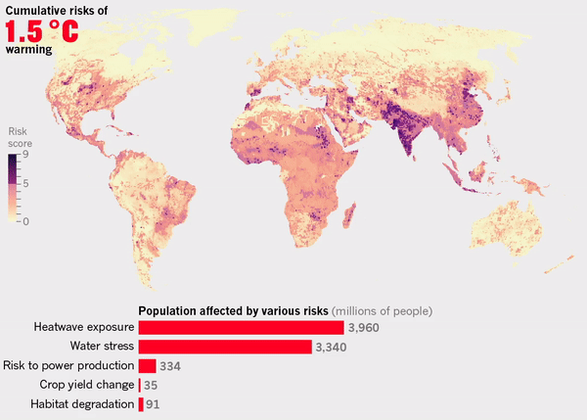
The risks associated with 1.5°C of warming and above
Source: IPCC / Byers et al. 2018 / Nature
Notes:
The shading of each ember provides a qualitative indication of the increase in risk with temperature for each individual “reason.”
Undetectable risk (white) indicates no associated impacts are detectable and attributable to climate change.
Moderate risk (yellow) indicates that associated impacts are both detectable and attributable to climate change with at least medium conﬁdence, also accounting for the other speciﬁc criteria for key risks.
High risk (red) indicates severe and widespread impacts, also accounting for the other speciﬁc criteria for key risks.
Purple, introduced in this assessment, shows that very high risk is indicated by all speciﬁc criteria for key risks.
Comparison of the increase of risk across RFCs indicates the relative sensitivity of RFCs to increases in GMT. In general, assessment of RFCs takes autonomous adaptation into account, as was done previously (Smith et al., 2001, 2009; Schneider et al., 2007). In addition, this assessment took into account limits to adaptation in the case of RFC1, RFC3, and RFC5, independent of the development pathway. The rate and timing of climate change and physical impacts, not illustrated explicitly in this diagram, were taken into account in assessing RFC1 and RFC5. Comments superimposed on RFCs provide additional details that were factored into the assessment. The levels of risk illustrated reﬂect the judgments of Chapter 19 authors.
Unique and threatened systems include a wide range of physical, biological, and human systems that are restricted to relatively narrow geographical ranges and are threatened by future changes in climate (Smith et al., 2001).
Extreme weather events (e.g., heat waves, intense precipitation, drought, tropical cyclones) trigger impacts that can pose key risks to societies that are exposed and vulnerable (Lavell et al., 2012).
The distribution of impacts is a category of climate change consequences that includes key risks to particular societies and social-ecological systems that may be disproportionately affected due to unequal distribution of hazards, exposure, or vulnerability.
The RFC pertaining to aggregate impacts includes risks that are aggregated globally into a single metric, such as monetary damages, lives affected, lives lost, or species or ecosystems lost. Estimates of the aggregate, economy-wide risks of climate change since AR4 continue to exhibit a low level of agreement. Studies at the sectoral level have been refined with new data and models, and have assessed new sectors.
Large-scale singular events (sometimes called “tipping points,” or critical thresholds) are abrupt and drastic changes in physical, ecological, or social systems in response to smooth variations in driving forces (Smith et al., 2001, 2009; McNeall et al., 2011). Combined with widespread vulnerability and exposure, they pose key risks because of the potential magnitude of the consequences; the rate at which they would occur; and, depending on this rate, the limited ability of society to cope with them.

Slide 8
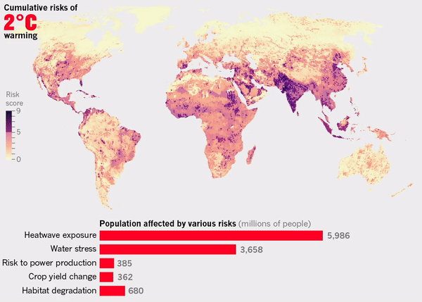
The risks associated with 1.5°C of warming and above
Source: IPCC / Byers et al. 2018 / Nature
Notes:
The shading of each ember provides a qualitative indication of the increase in risk with temperature for each individual “reason.”
Undetectable risk (white) indicates no associated impacts are detectable and attributable to climate change.
Moderate risk (yellow) indicates that associated impacts are both detectable and attributable to climate change with at least medium conﬁdence, also accounting for the other speciﬁc criteria for key risks.
High risk (red) indicates severe and widespread impacts, also accounting for the other speciﬁc criteria for key risks.
Purple, introduced in this assessment, shows that very high risk is indicated by all speciﬁc criteria for key risks.
Comparison of the increase of risk across RFCs indicates the relative sensitivity of RFCs to increases in GMT. In general, assessment of RFCs takes autonomous adaptation into account, as was done previously (Smith et al., 2001, 2009; Schneider et al., 2007). In addition, this assessment took into account limits to adaptation in the case of RFC1, RFC3, and RFC5, independent of the development pathway. The rate and timing of climate change and physical impacts, not illustrated explicitly in this diagram, were taken into account in assessing RFC1 and RFC5. Comments superimposed on RFCs provide additional details that were factored into the assessment. The levels of risk illustrated reﬂect the judgments of Chapter 19 authors.
Unique and threatened systems include a wide range of physical, biological, and human systems that are restricted to relatively narrow geographical ranges and are threatened by future changes in climate (Smith et al., 2001).
Extreme weather events (e.g., heat waves, intense precipitation, drought, tropical cyclones) trigger impacts that can pose key risks to societies that are exposed and vulnerable (Lavell et al., 2012).
The distribution of impacts is a category of climate change consequences that includes key risks to particular societies and social-ecological systems that may be disproportionately affected due to unequal distribution of hazards, exposure, or vulnerability.
The RFC pertaining to aggregate impacts includes risks that are aggregated globally into a single metric, such as monetary damages, lives affected, lives lost, or species or ecosystems lost. Estimates of the aggregate, economy-wide risks of climate change since AR4 continue to exhibit a low level of agreement. Studies at the sectoral level have been refined with new data and models, and have assessed new sectors.
Large-scale singular events (sometimes called “tipping points,” or critical thresholds) are abrupt and drastic changes in physical, ecological, or social systems in response to smooth variations in driving forces (Smith et al., 2001, 2009; McNeall et al., 2011). Combined with widespread vulnerability and exposure, they pose key risks because of the potential magnitude of the consequences; the rate at which they would occur; and, depending on this rate, the limited ability of society to cope with them.

Slide 9
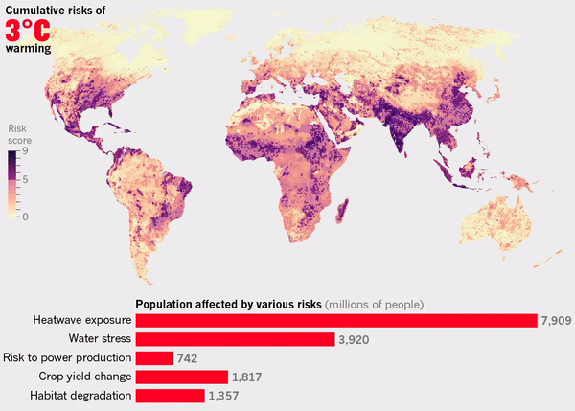
The risks associated with 1.5°C of warming and above
Source: IPCC / Byers et al. 2018 / Nature
Notes:
The shading of each ember provides a qualitative indication of the increase in risk with temperature for each individual “reason.”
Undetectable risk (white) indicates no associated impacts are detectable and attributable to climate change.
Moderate risk (yellow) indicates that associated impacts are both detectable and attributable to climate change with at least medium conﬁdence, also accounting for the other speciﬁc criteria for key risks.
High risk (red) indicates severe and widespread impacts, also accounting for the other speciﬁc criteria for key risks.
Purple, introduced in this assessment, shows that very high risk is indicated by all speciﬁc criteria for key risks.
Comparison of the increase of risk across RFCs indicates the relative sensitivity of RFCs to increases in GMT. In general, assessment of RFCs takes autonomous adaptation into account, as was done previously (Smith et al., 2001, 2009; Schneider et al., 2007). In addition, this assessment took into account limits to adaptation in the case of RFC1, RFC3, and RFC5, independent of the development pathway. The rate and timing of climate change and physical impacts, not illustrated explicitly in this diagram, were taken into account in assessing RFC1 and RFC5. Comments superimposed on RFCs provide additional details that were factored into the assessment. The levels of risk illustrated reﬂect the judgments of Chapter 19 authors.
Unique and threatened systems include a wide range of physical, biological, and human systems that are restricted to relatively narrow geographical ranges and are threatened by future changes in climate (Smith et al., 2001).
Extreme weather events (e.g., heat waves, intense precipitation, drought, tropical cyclones) trigger impacts that can pose key risks to societies that are exposed and vulnerable (Lavell et al., 2012).
The distribution of impacts is a category of climate change consequences that includes key risks to particular societies and social-ecological systems that may be disproportionately affected due to unequal distribution of hazards, exposure, or vulnerability.
The RFC pertaining to aggregate impacts includes risks that are aggregated globally into a single metric, such as monetary damages, lives affected, lives lost, or species or ecosystems lost. Estimates of the aggregate, economy-wide risks of climate change since AR4 continue to exhibit a low level of agreement. Studies at the sectoral level have been refined with new data and models, and have assessed new sectors.
Large-scale singular events (sometimes called “tipping points,” or critical thresholds) are abrupt and drastic changes in physical, ecological, or social systems in response to smooth variations in driving forces (Smith et al., 2001, 2009; McNeall et al., 2011). Combined with widespread vulnerability and exposure, they pose key risks because of the potential magnitude of the consequences; the rate at which they would occur; and, depending on this rate, the limited ability of society to cope with them.

Slide 10
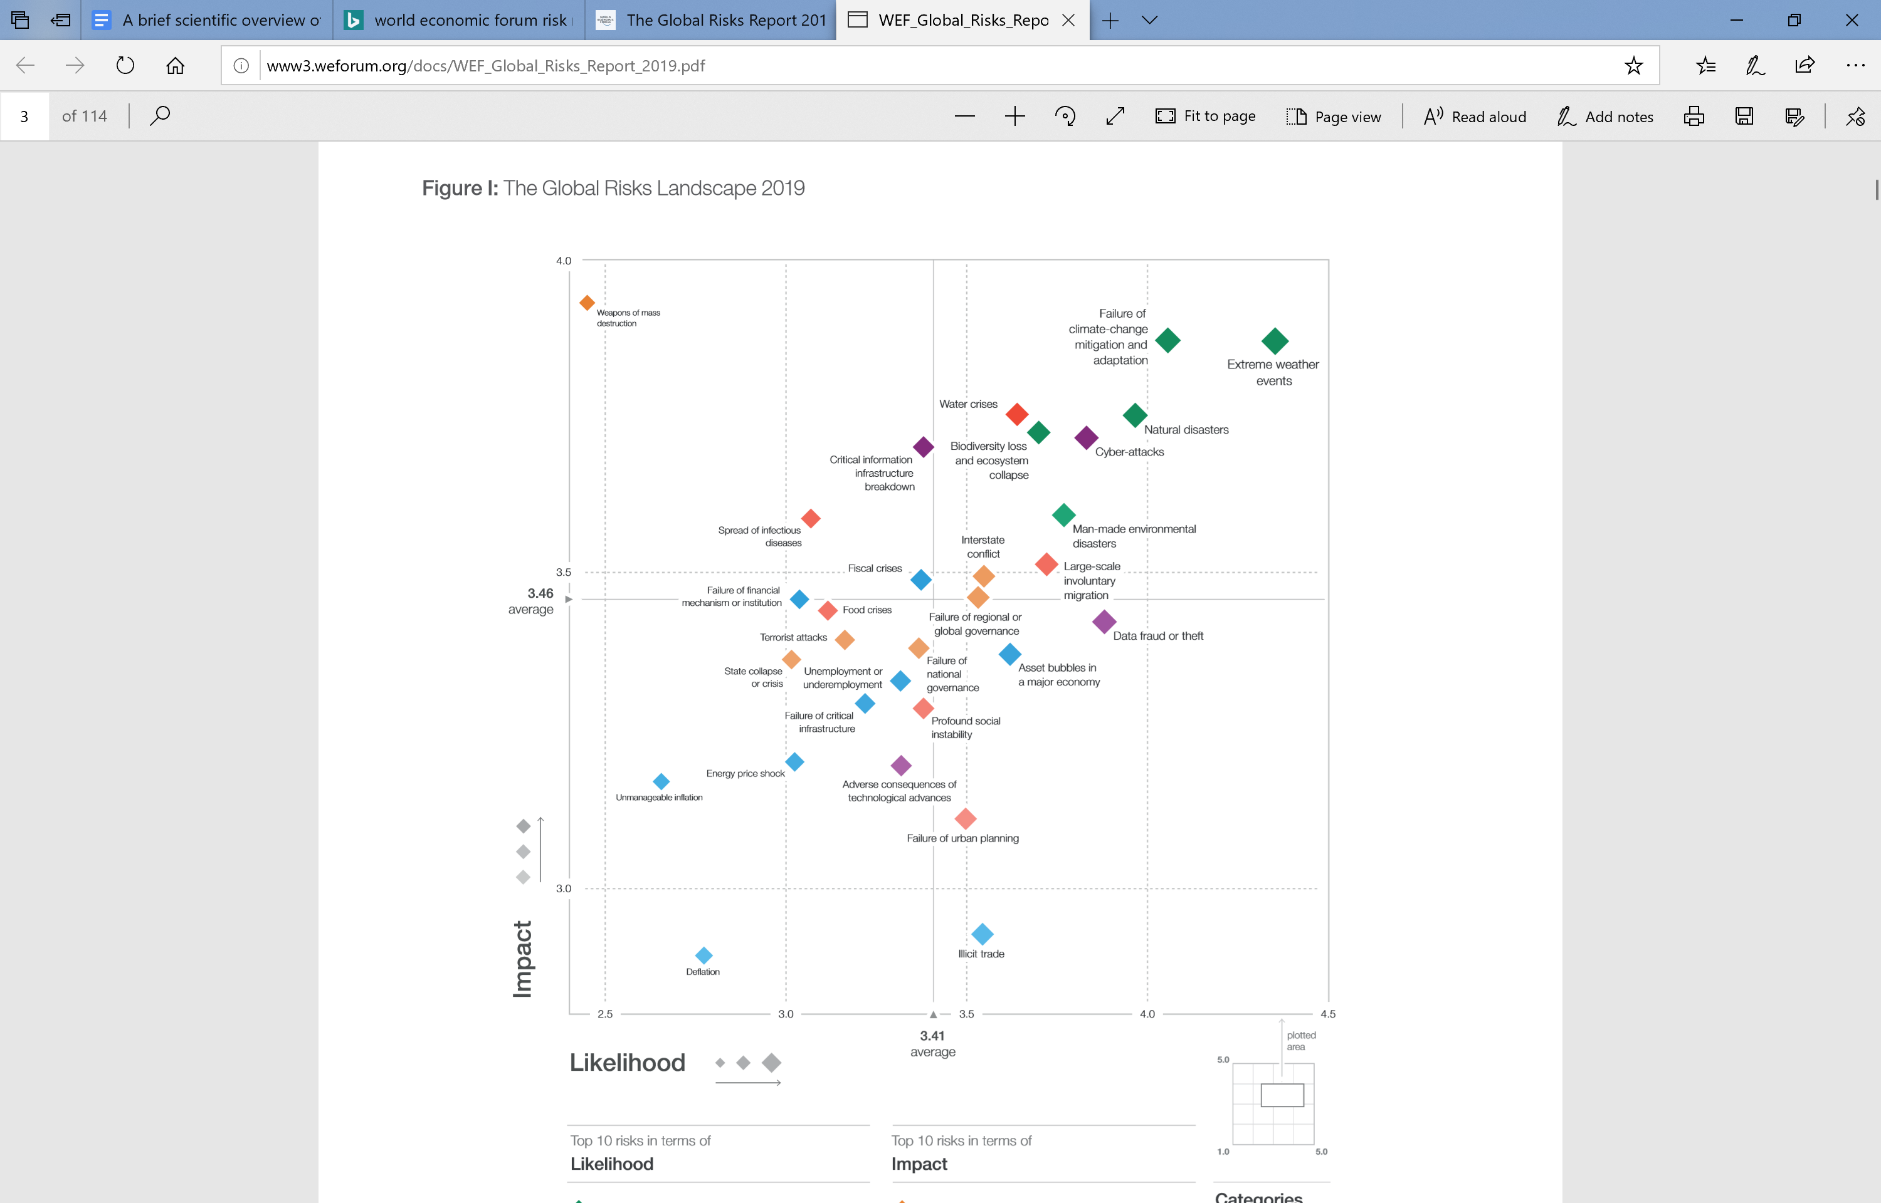
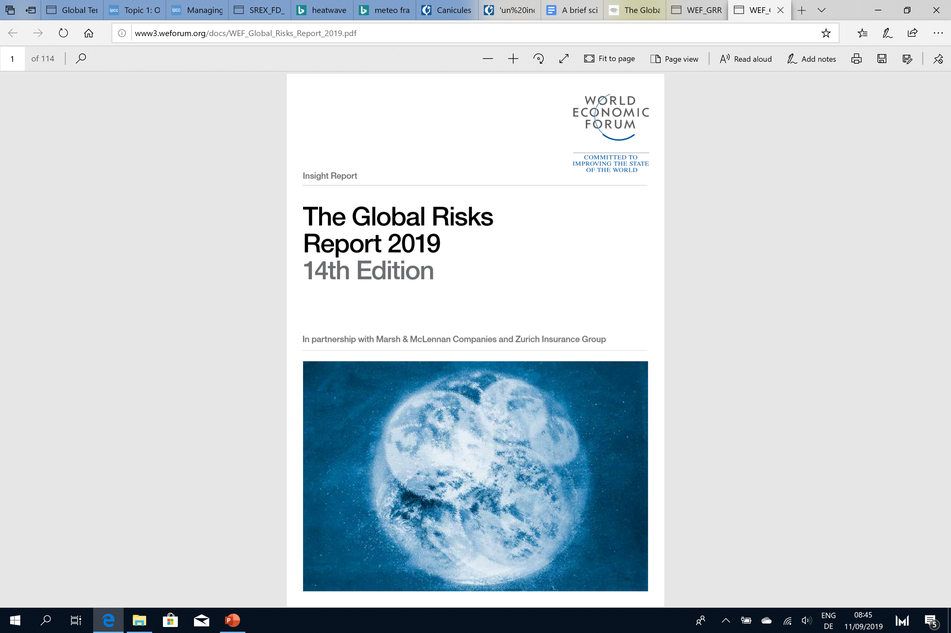
The risks associated with 1.5°C of warming and above
Source: WEF 2019

Slide 11
The implications of staying below 1.5°C
Fossil fuel reserves
4000 GtCO₂
2°C carbon budget
1130 GtCO₂
1.5°C carbon budget
380 GtCO₂
Source: IPCC SR1.5 2018 (Chap. 2), own calculation

Slide 12
The implications of staying below 1.5°C
Global annual emissions GtCO₂
50
40
30
Historical
emissions
Budget exhausted
in 10 years
400
GtCO₂
20
10
0
2000
2010
2020
2030
2040
2050

Slide 13
The implications of staying below 1.5°C
Global annual emissions GtCO₂
50
40
50% emission
reduction in
10 years
30
Historical
emissions
Budget exhausted
in 20 years
20
400
GtCO₂
10
0
2000
2010
2020
2030
2040
2050

Slide 14
The implications of staying below 1.5°C
Global annual emissions GtCO₂
50
Budget overdraft
40
30
Historical
emissions
20
400
GtCO₂
10
0
Carbon dioxide removal
(CDR) techs
2000
2010
2020
2030
2040
2050

Slide 15






The implications of staying below 1.5°C
1. Rapid and deep near-term decarbonization of energy supply
Fossil fuels
Nuclear
Renewables
-58%
+134%
+262%
Source: IPCC SR1.5 2018 (Chap. 2)

Slide 16


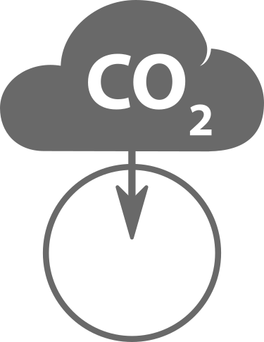
The implications of staying below 1.5°C
2. Greater energy demand reductions
Energy efficiency
3. Electrification of end-uses
4. Major shift in investments
$
830 billion USD2010 (2016-2050)
5. Deployment of CDR techs
3-7 GtCO₂ by 2050
Source: IPCC SR1.5 2018 (Chap. 2)

Slide 17
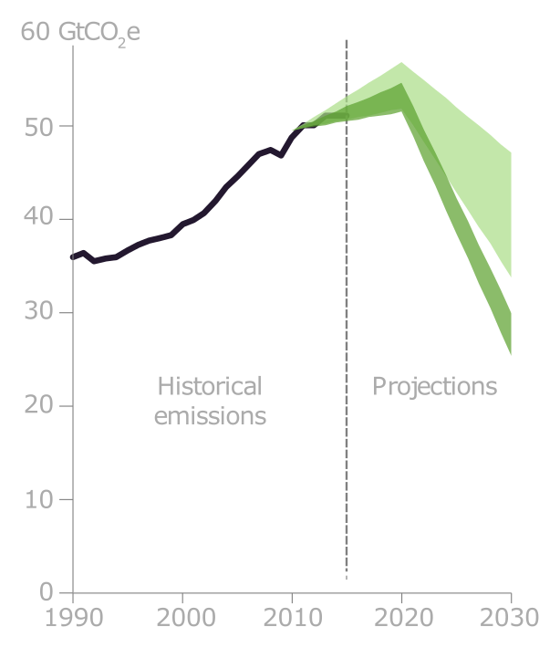
Current ambition is insufficient
1.5°C and 2°C scenarios
(Paris Agreement compatible)
Source: IPCC SR1.5 2018 (Chap. 2) / Nature

Slide 18
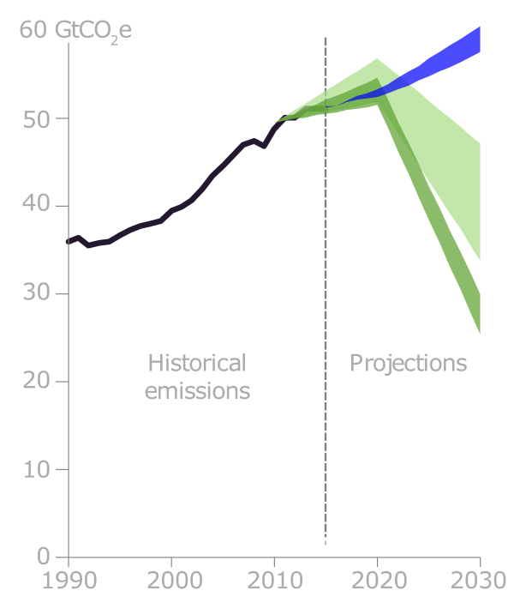
Current ambition is insufficient
Current policies
1.5°C and 2°C scenarios
(Paris Agreement compatible)
Source: IPCC SR1.5 2018 (Chap. 2) / Nature

Slide 19
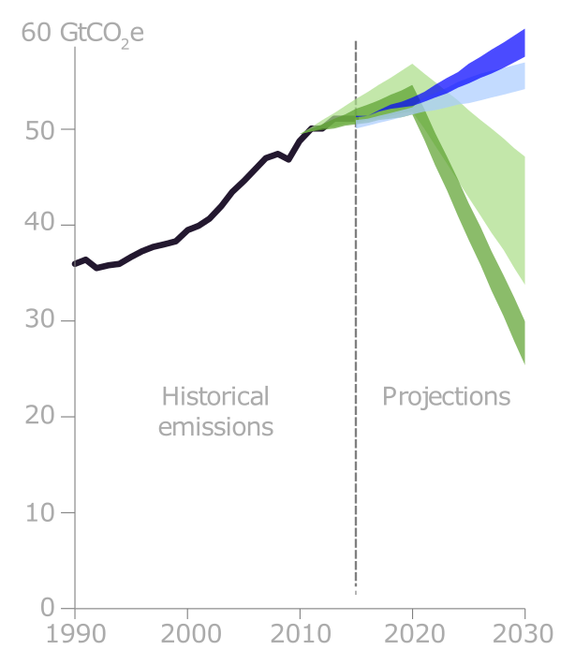
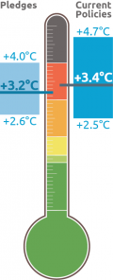
Current ambition is insufficient
Current policies
Pledges
1.5°C and 2°C scenarios
(Paris Agreement compatible)
Source: IPCC SR1.5 2018 (Chap. 2) / Nature, Climate Analytics

Slide 20
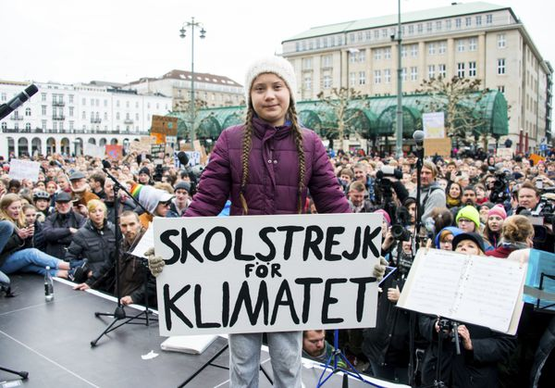
Current ambition is insufficient

Slide 21
4 take home messages
Our past and current GHG emissions have altered the climate system (+1°C) and many climate-change related hazards are impacting human and natural systems across the globe.
We need to keep global warming well-below 2°C and continue efforts to limit it to 1.5°C to reduce risks and avoid dangerous anthropogenic interference of the climate system
We have a limited carbon budget of about 380 GtCO₂ to keep warming below 1.5°C
We need to seriously strengthen our efforts! (e.g. more policy incentives, more investments, more actors, more R&D)

Slide 22
Backup slides

Slide 23
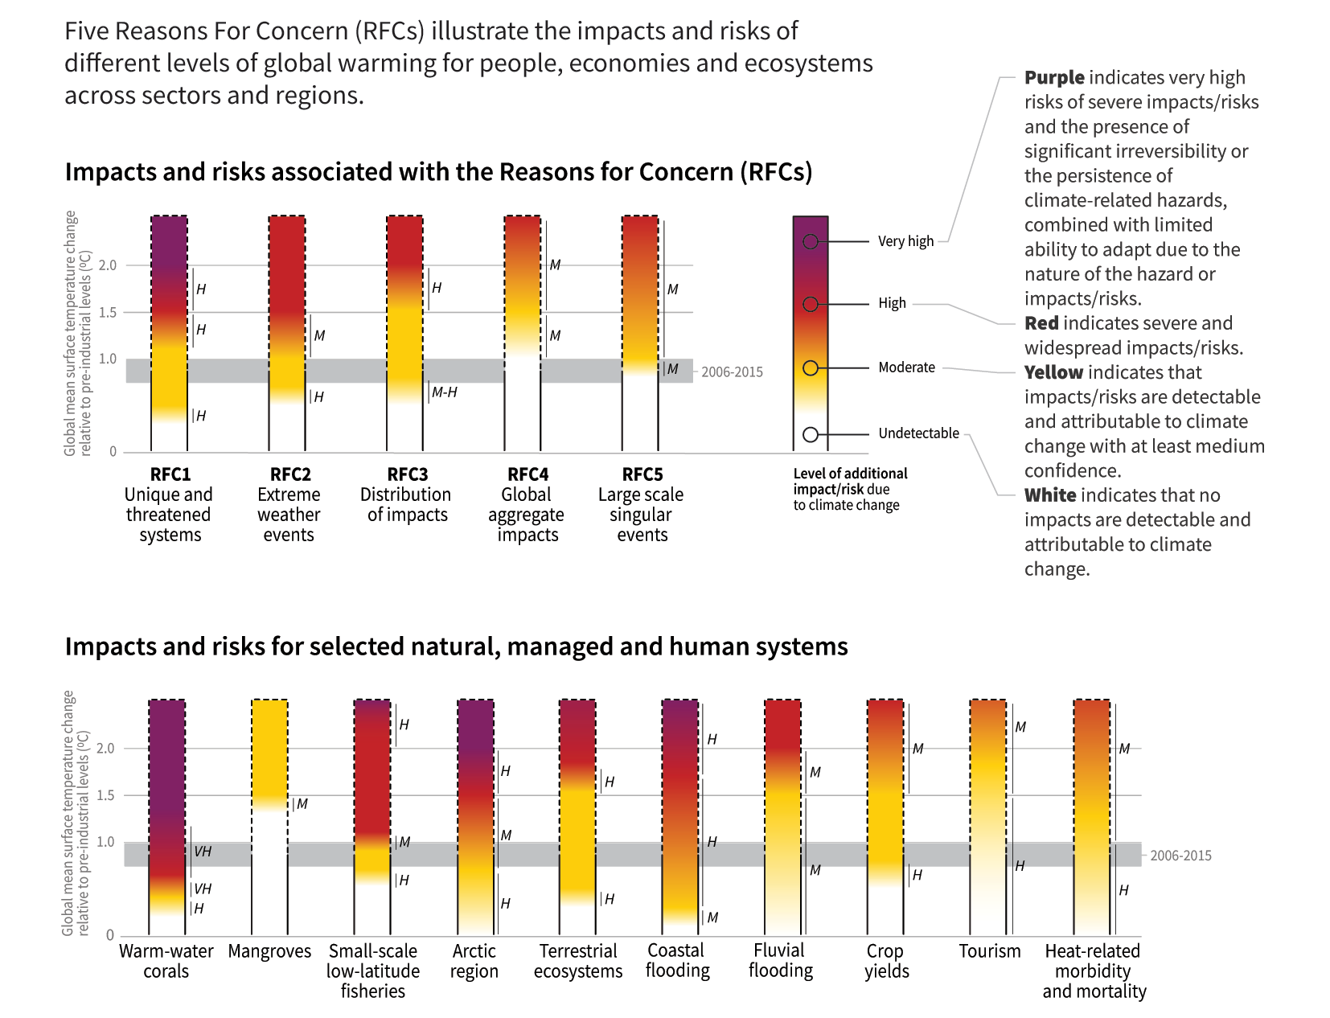
SR1.5: Risks to natural & humans systems

Slide 24
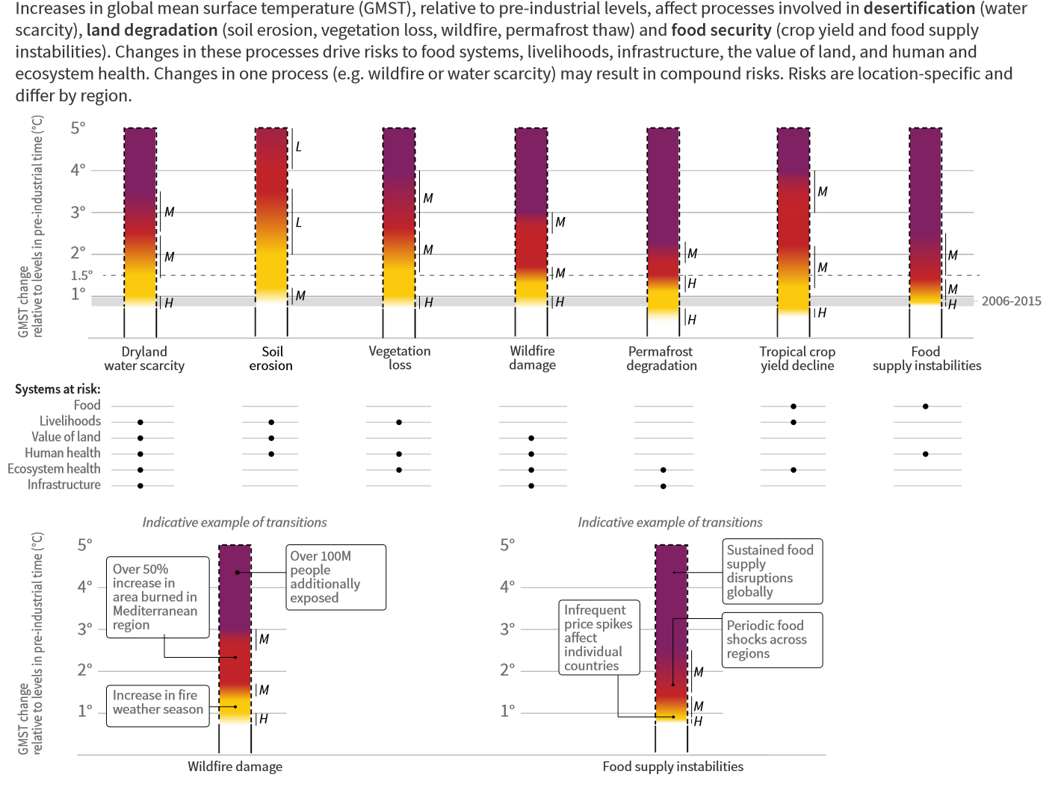
SRCCL: Risks to humans and ecosystems

Slide 25
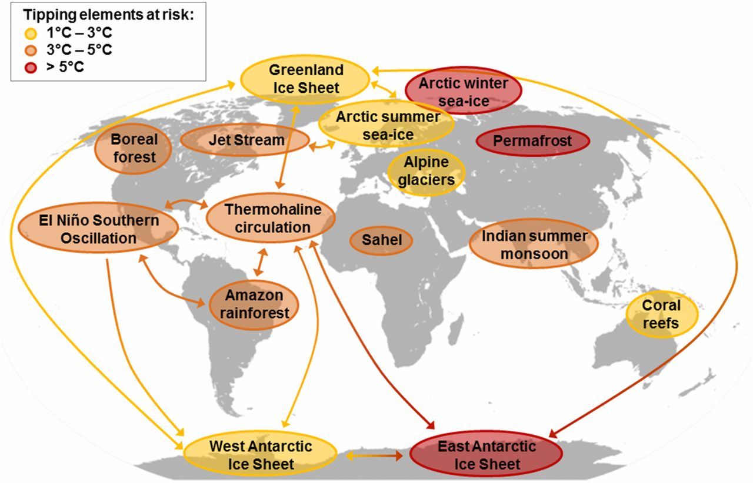
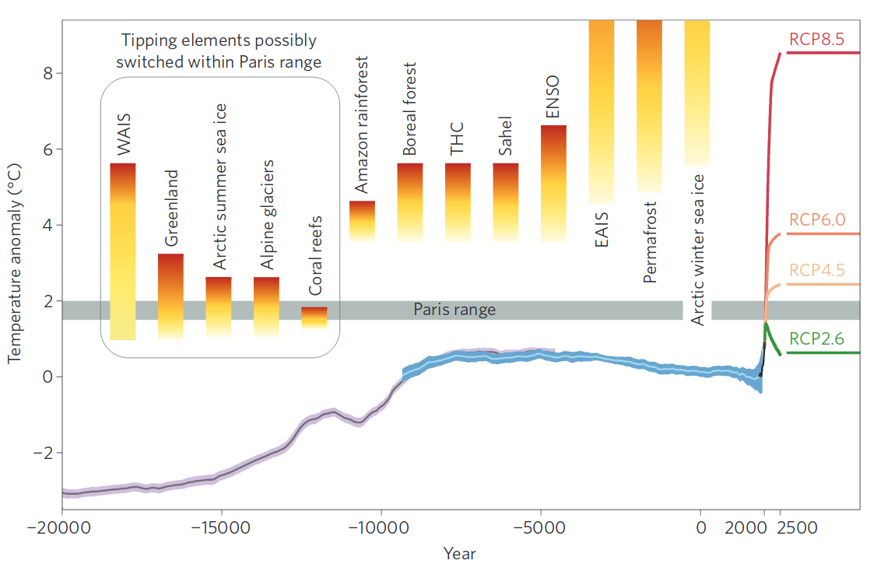
Tipping points

Slide 26
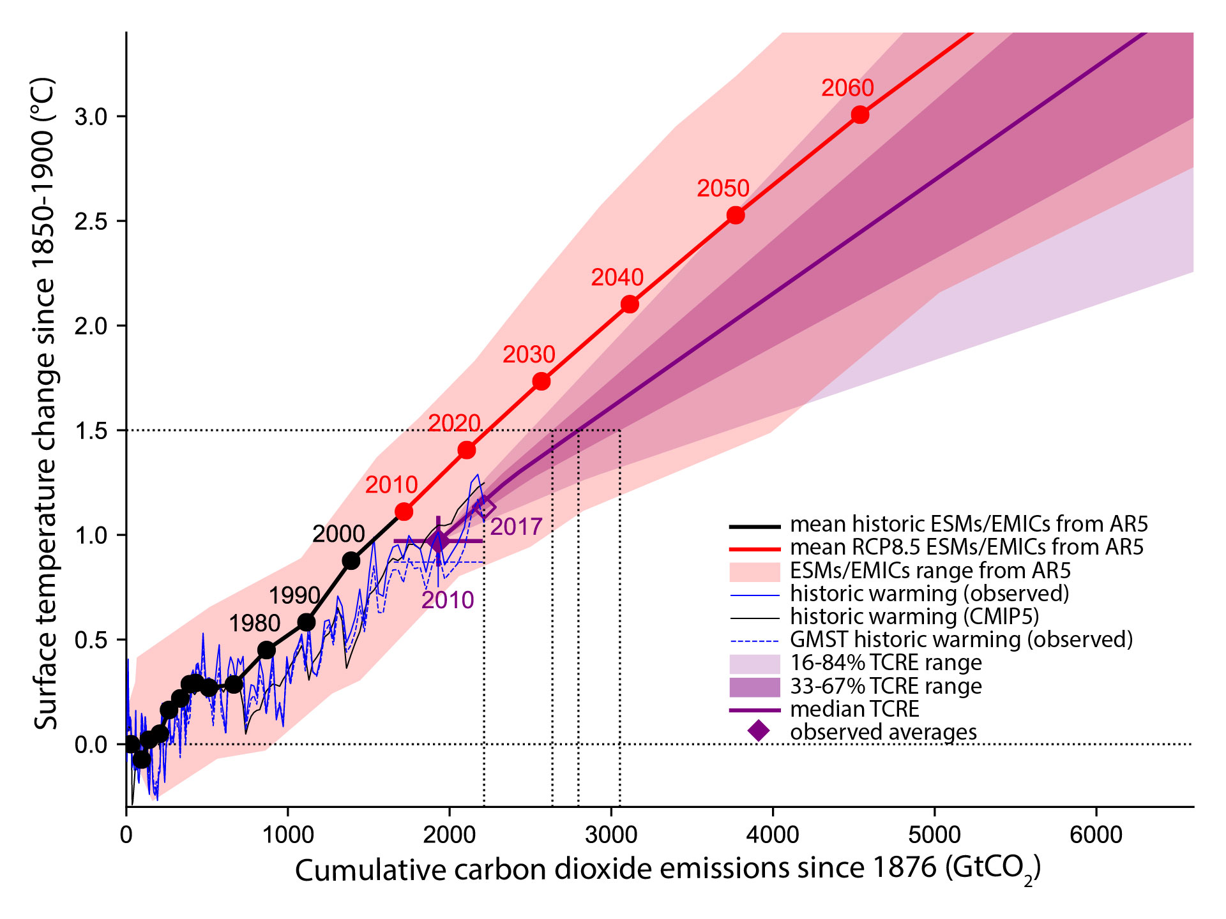
Carbon budget

Slide 27
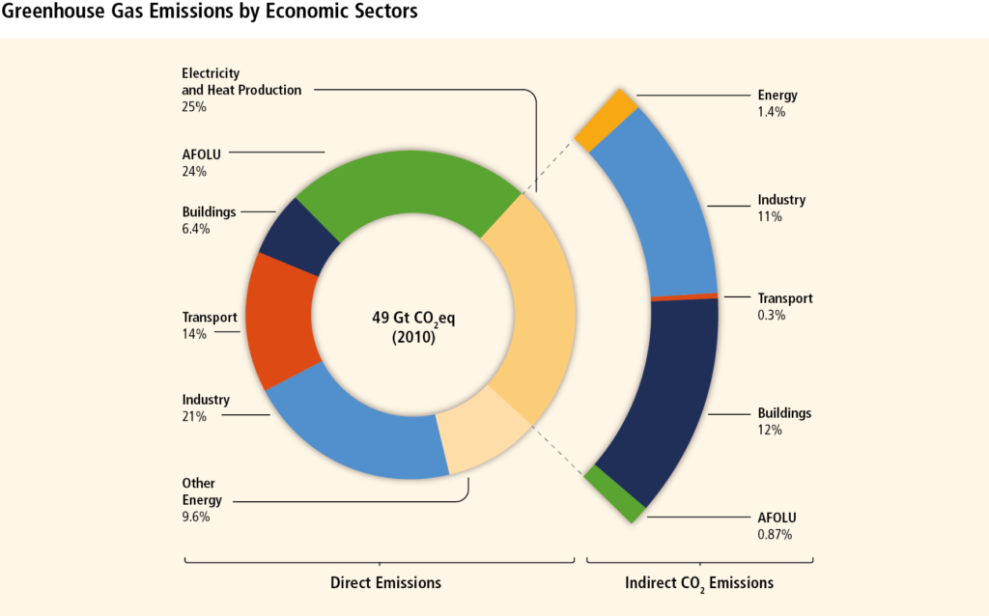
AR5: GHG by economic sector

Slide 28
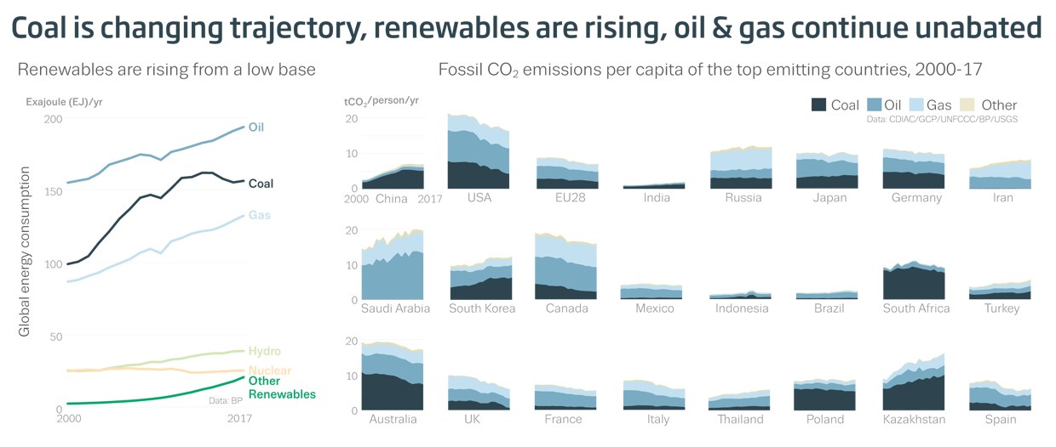
GHG by economic sector

Slide 29
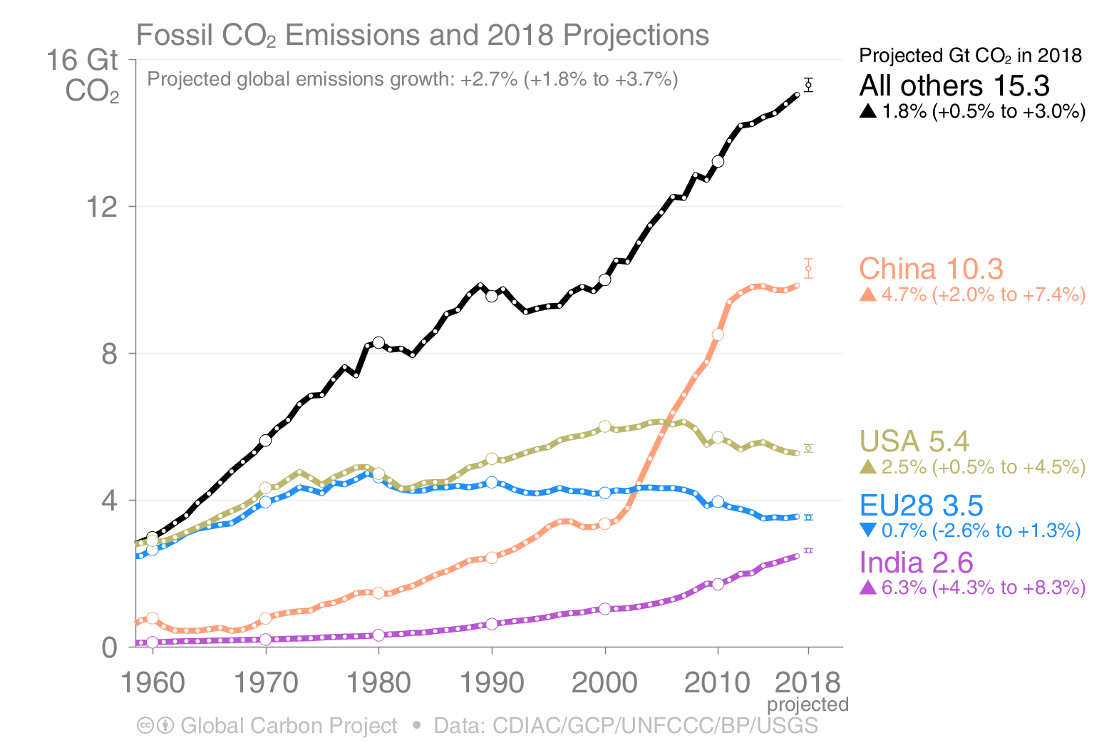
GCP: CO2 emissions by country

Slide 30
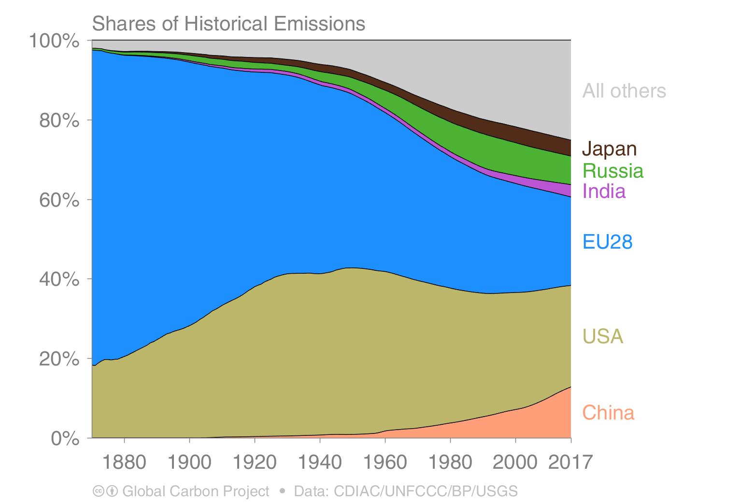
GCP: Shares of historical emissions

Slide 31
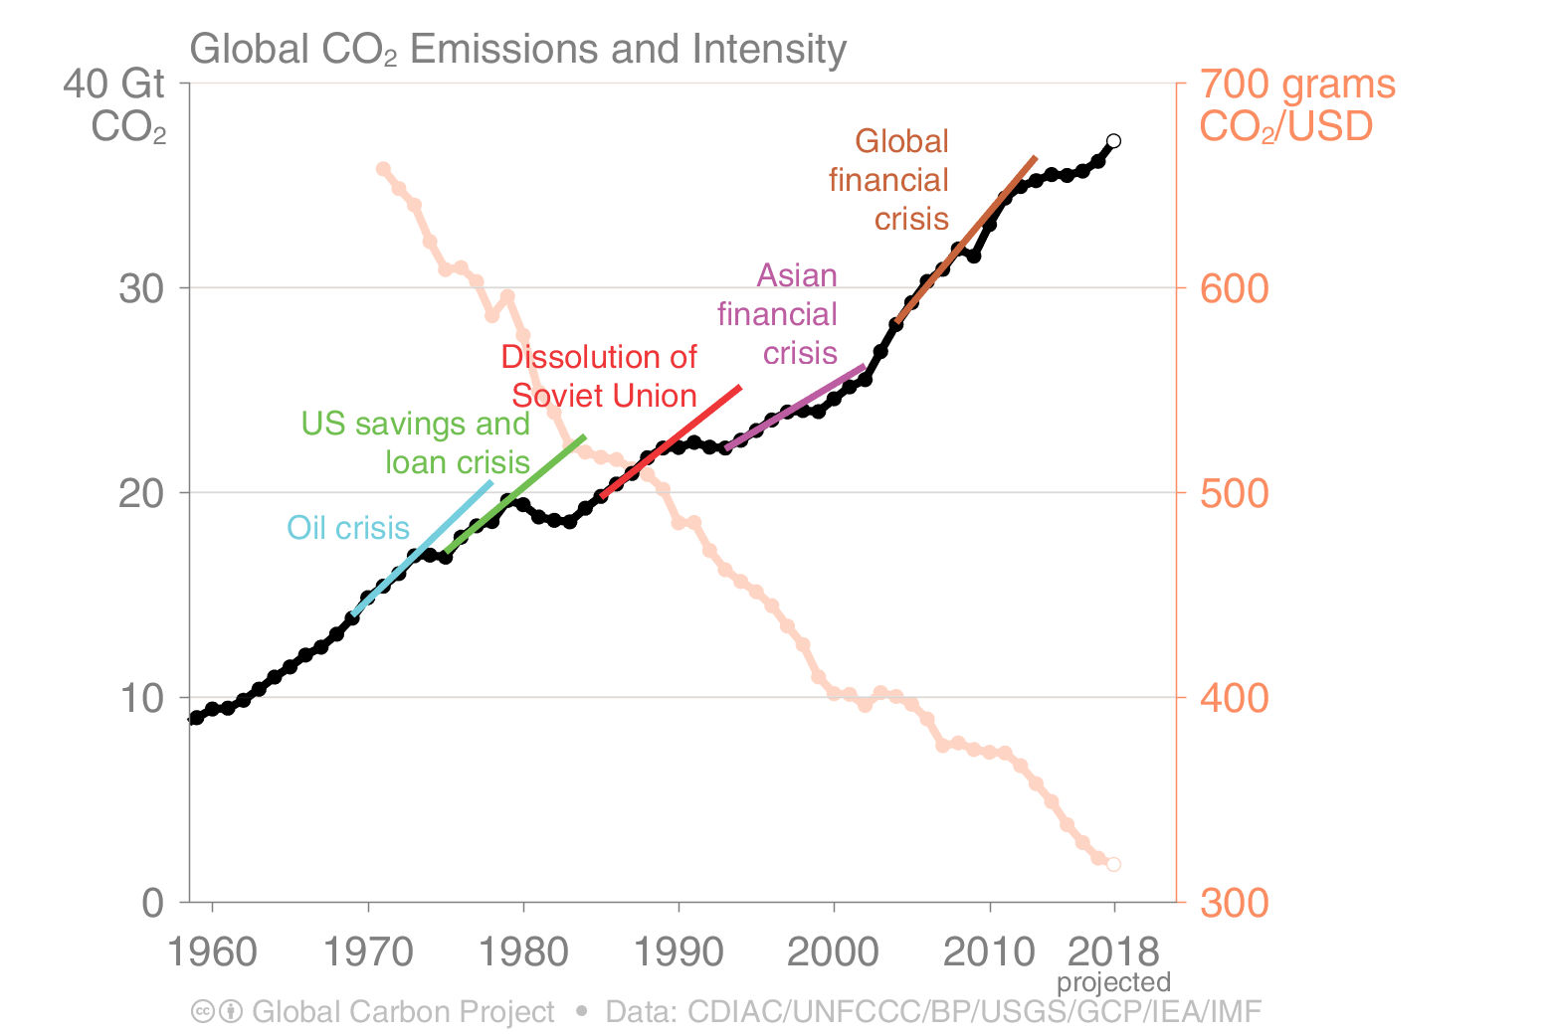
GCP: Financial crises

Slide 32
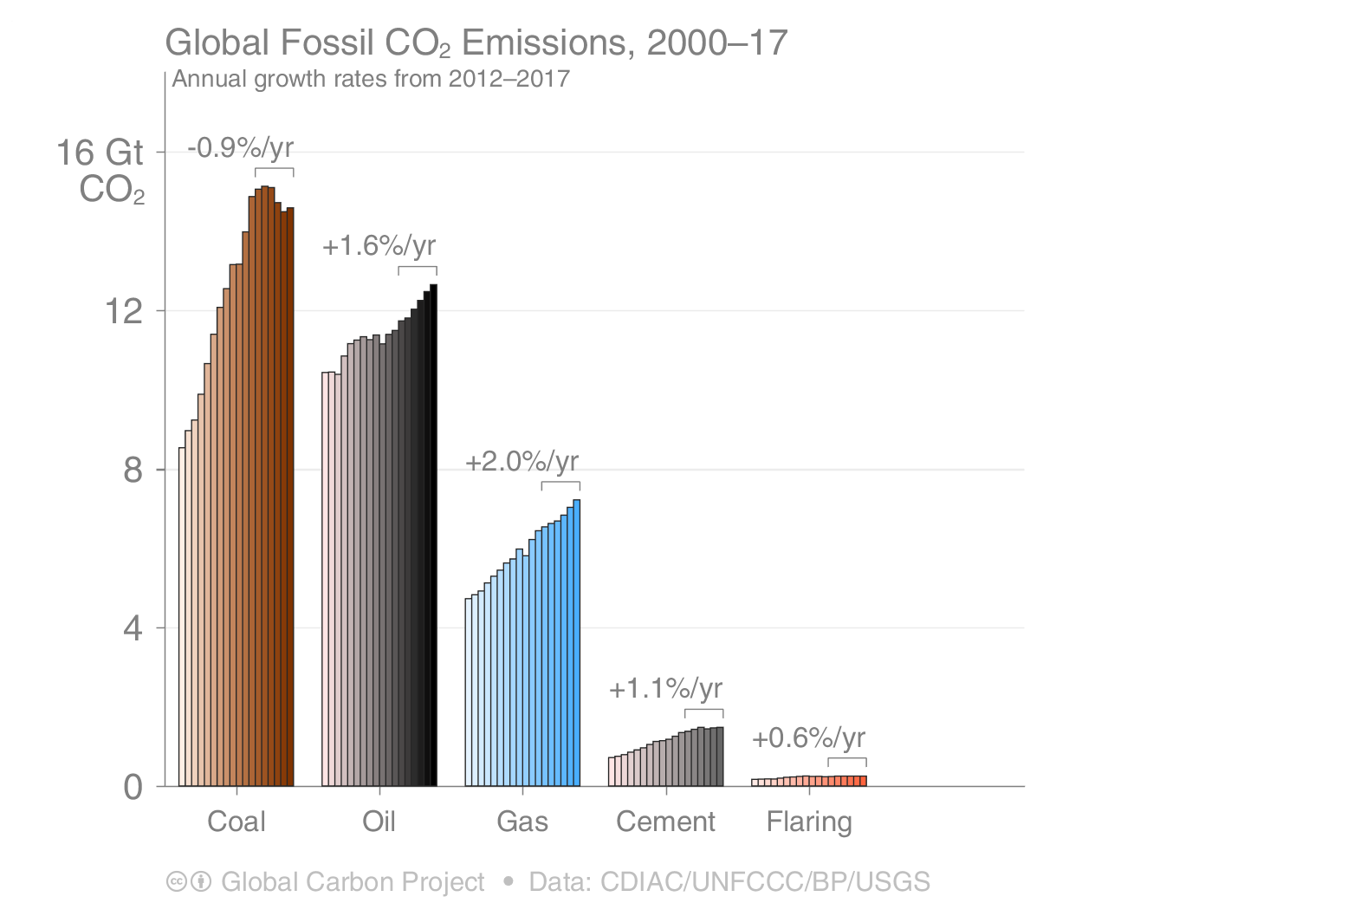
GCP: Fossil fuel CO2 emissions

Slide 33
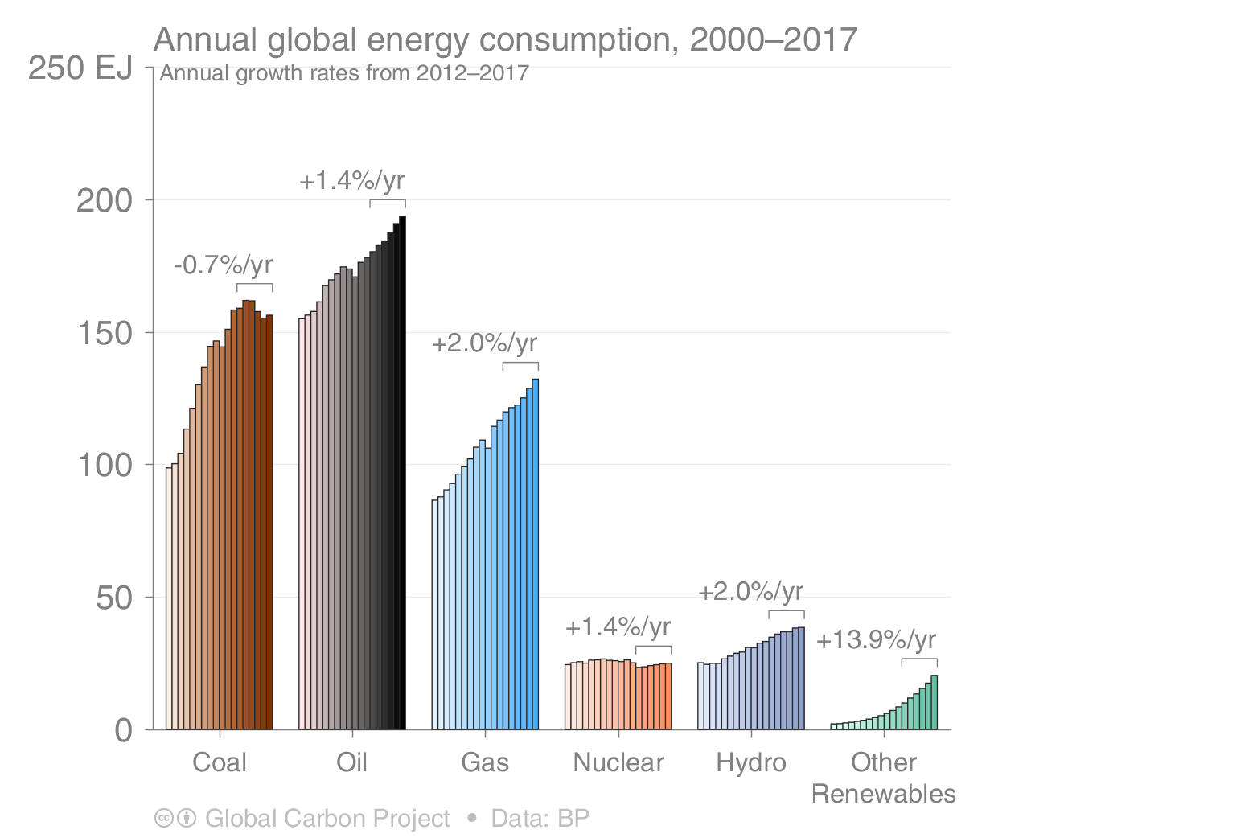
GCP: Energy consumption

Slide 34
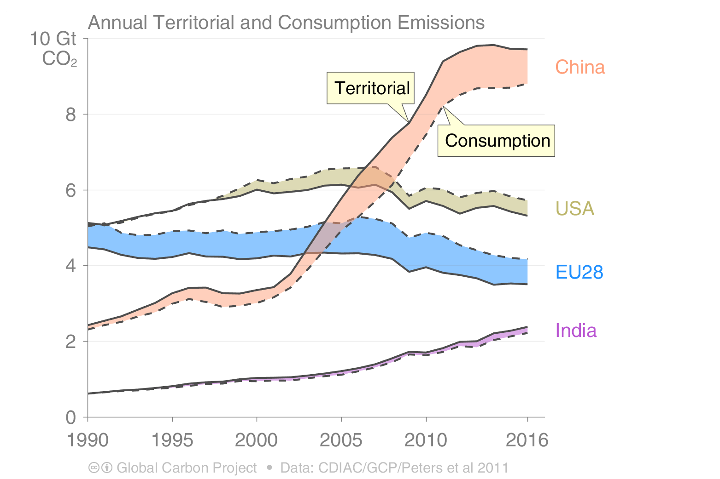
GCP: Territorial vs Consumption emissions

Slide 35
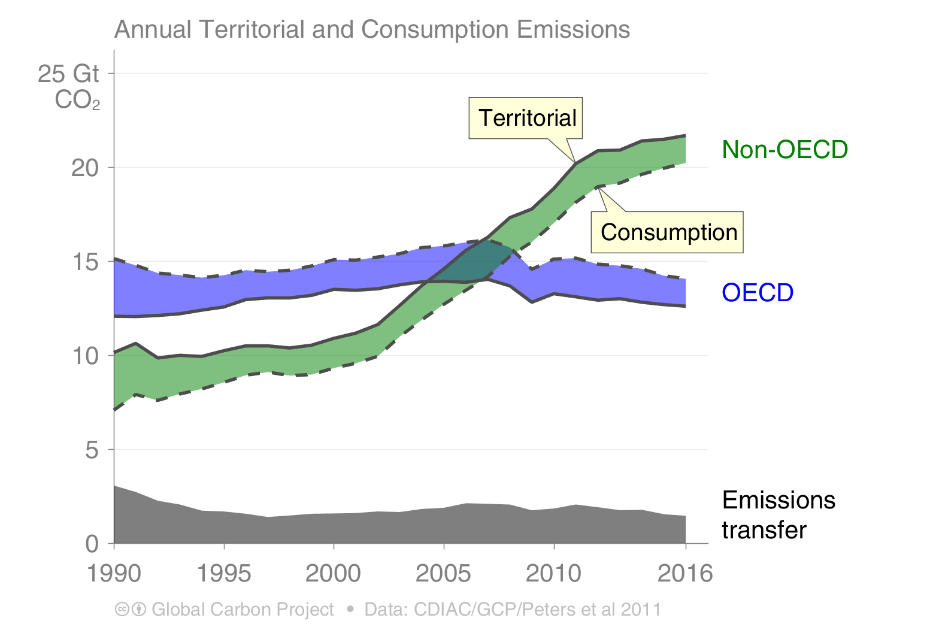
GCP: T vs C emissions (OECD vs non OECD)

Slide 36
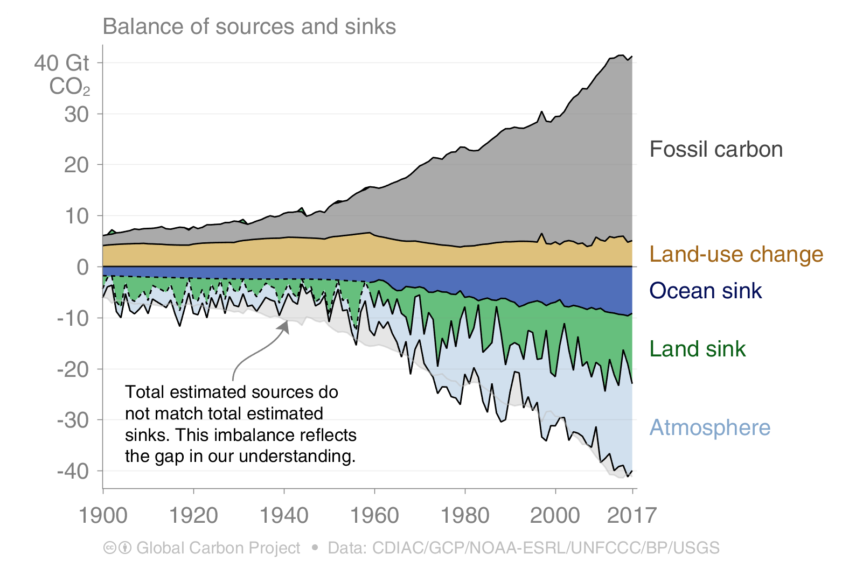
GCP: Sources and sinks

Slide 37
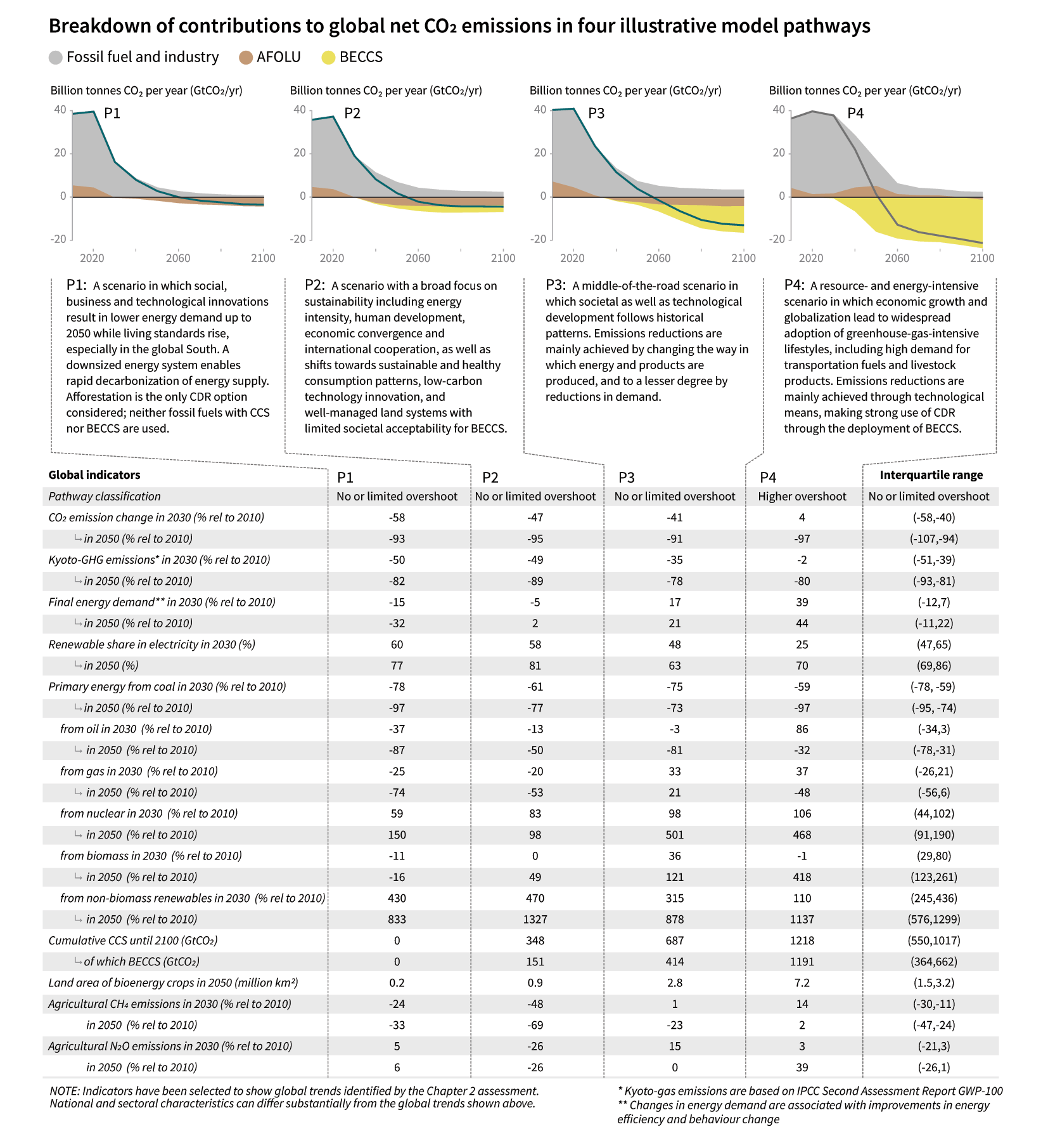
Characteristics of 4 illustrative pathways

Slide 38
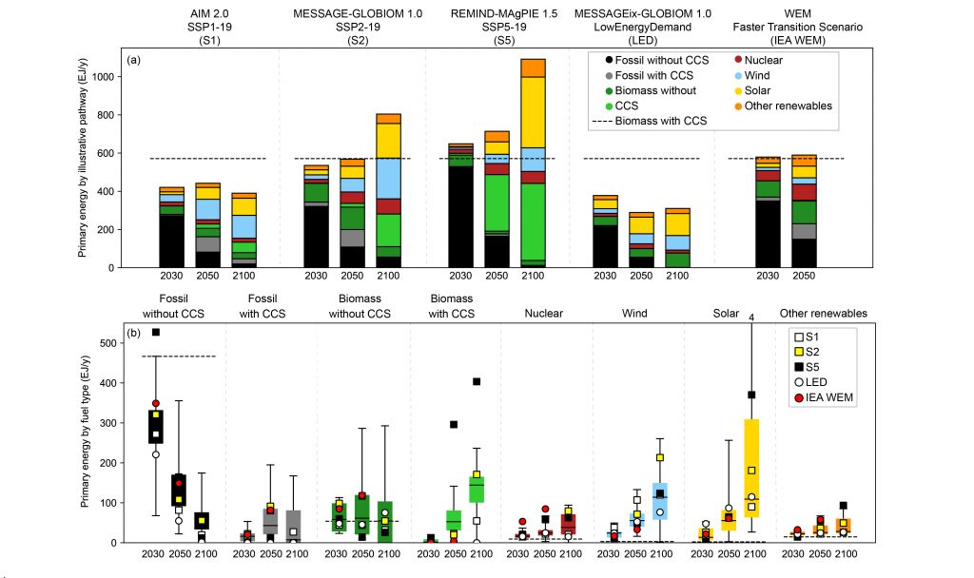
Primary energy supply

Slide 39
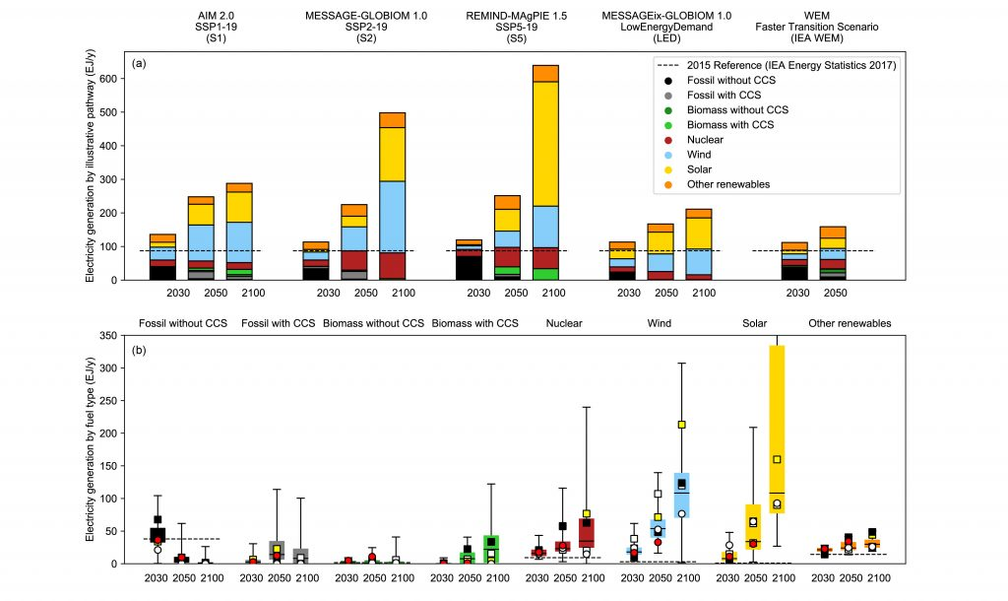
Electricity generation

Slide 40
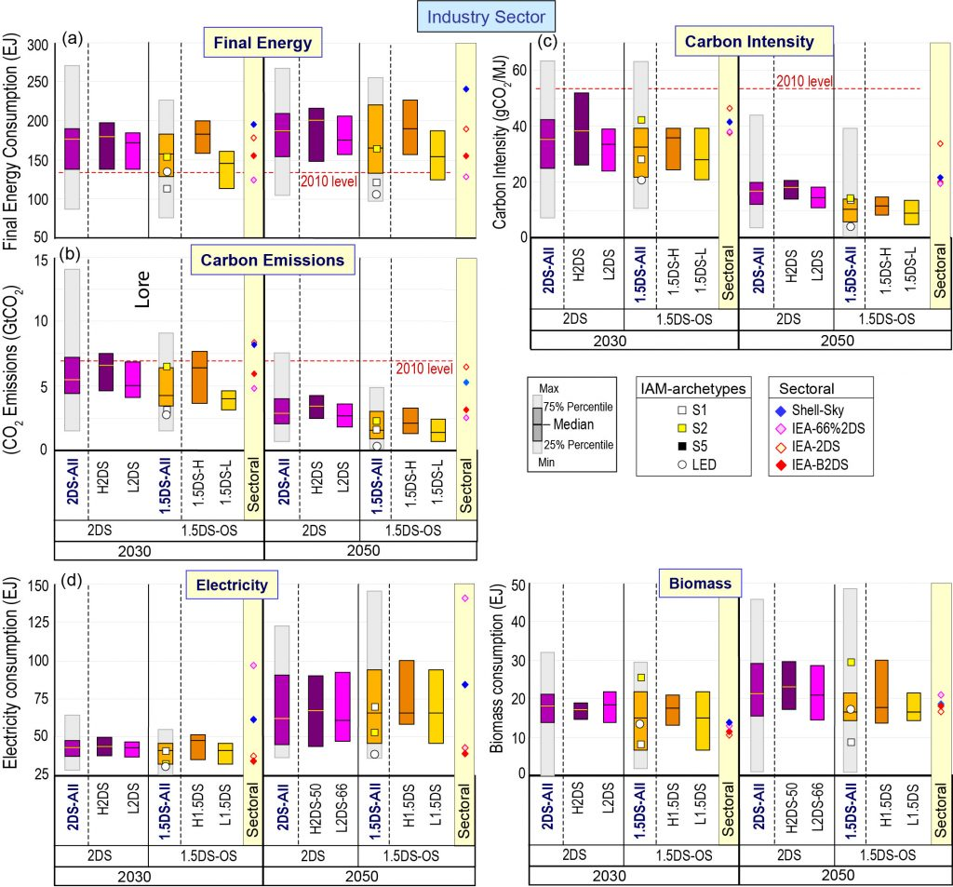
Industry sector

Slide 41
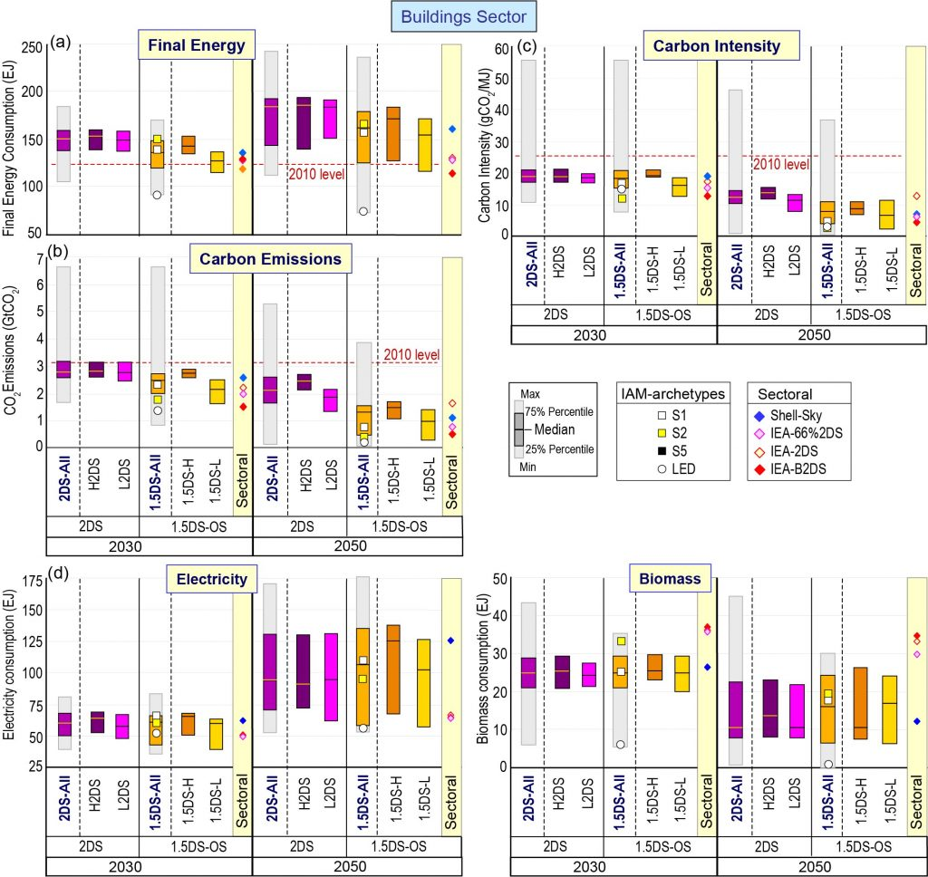
Buildings sector

Slide 42
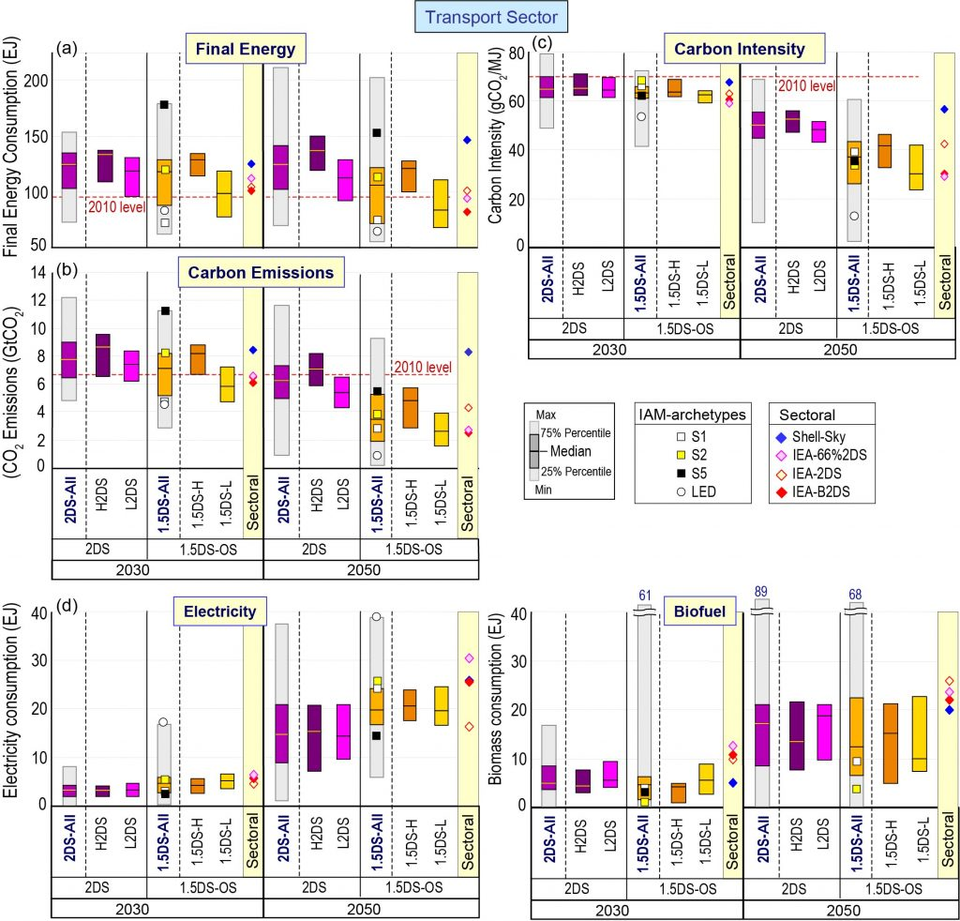
Transport sector

Slide 43
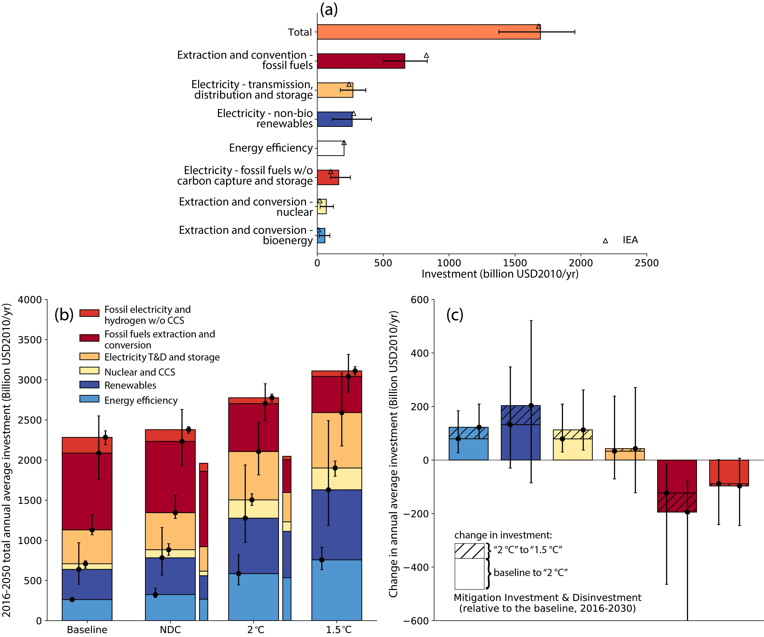
Historical and projected global energy investments

